Slide 1

Wand Man
By MagiDev

Slide 2
The Dream Team
Bar Ben-zvi – Design Director
Eli Miller – Technical Director
Hunter Starr –Art Director
Nelson Athow - Producer

Slide 3
Art Theme

Slide 4
Audio Theme

Slide 5

Area 1 “The Underground Cemetery.”
The Underground Cemetery is dark and eerie, with generally dark themes and undead enemies.
The Aural theme for The Underground Cemetery is Eerie and slow.
The Aural theme for the boss fight is moderately faster than the main level, and incorporates glissandos and larger scale hops.

Slide 6


Area 2 “The Living Library”
The Living Library is a place of knowledge and Magic. There are bookshelves everywhere and the enemies are either Magic users or Magically animated.
The Aural theme of The Living Library is relaxed, chill, and melodic.
The Aural theme of the boss fight is tense, and much faster than the theme of the Main level.

Slide 7
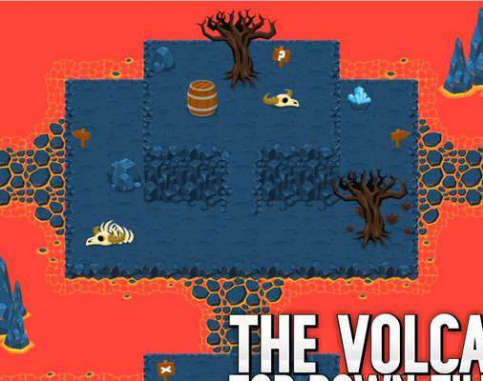
Area 3
Error. Insufficient information.

Slide 8
Design Protoype

Slide 9
Core System

Slide 10
Game State Summary

